Slide 1
Year 10 Subject Selection for Stage 6
For Year 10 students and their parents.

Slide 2
Year 10 Subject Selection for Stage 6
Purpose of this presentation
This presentation has been developed to assist schools to provide relevant NSW Education Standards Authority (NESA) information to Year 10 students and their parents.

Slide 3
Year 10 Subject Selection for Stage 6
Course Selection Considerations
Abilities
Interests/Motivation
Career aspirations and needs
Syllabus requirements - Practical/Major work components
Subject combinations
Other commitments
Notes:
Abilities - choose subjects where you are capable of doing well.
Interests/Motivation- choose subjects that interest you.
Career aspirations and needs - keep in mind future career paths but be realistic about choices.
Syllabus Requirements – be mindful of how many practical works and major works are required for your pattern of study and the timing of submission.
Subject combinations - do the subjects complement each other?
Other commitments - when choosing subjects, it its important to balance study with outside commitments and influences such as work, sport and family.
http://educationstandards.nsw.edu.au/wps/portal/nesa/11-12/hsc/subject-selection

Slide 4
Year 10 Subject Selection for Stage 6
The Higher School Certificate
is the culmination of a student’s school career
is the highest educational award that can be achieved at secondary school in New South Wales
reports student achievement in terms of a standard achieved in individual courses
presents a profile of student achievement across a broad range of subjects
Notes:
http://educationstandards.nsw.edu.au/wps/portal/nesa/11-12/hsc/subject-selection

Slide 5
Year 10 Subject Selection for Stage 6
HSC Course Structure
All courses in the HSC have a unit value
Most courses are 2 units which equates to 120 hours of study and an HSC result out of 100
Some courses are 1 unit. This is equivalent to 60 hours of study and a HSC result out of 50
Many 1 unit courses are extension courses, enabling 3 or 4 units of a course to be studied
Notes:
http://ace.bostes.nsw.edu.au/ace-8064
http://educationstandards.nsw.edu.au/wps/portal/nesa/11-12/hsc/subject-selection

Slide 6
Year 10 Subject Selection for Stage 6
Requirements for the HSC
Year 11 (Terms 1 to 3 in 2018)
minimum of 12 units
students must satisfactorily complete the Year 11 course before commencing the corresponding Year 12 course
Year 12 (Term 4 in 2018, Terms 1 to 3 in 2019)
minimum of 10 units
Notes:
Students may accumulate course units towards the HSC for a period of up to 5 years.
Students may choose to undertake this ‘pathway’ approach for a variety of reasons including:
commitments outside school - part time work, elite sportsperson etc.
apprenticeship or traineeship
acceleration
repeating
http://ace.bostes.nsw.edu.au/ace-8036
http://educationstandards.nsw.edu.au/wps/portal/nesa/11-12/hsc/subject-selection

Slide 7
Year 10 Subject Selection for Stage 6
Requirements for the HSC
Both the Year 11 and Year 12 pattern of study must include:
2 units of compulsory English
at least 6 units of Board Developed Courses
at least 3 courses of 2 units value or greater
at least 4 subjects (including English)
a maximum of 6 units of Science may be included in the Year 11 pattern of study.
from 2019, a maximum of 7 units of Science may be included in the Year 12 pattern of study.
Notes:
English is mandatory for the HSC.
English Studies and Mathematics Standard 1 are Board Developed Courses with an optional HSC examination. Students who choose English Studies and/or Mathematics Standard 1, but wish to receive an ATAR, must undertake the optional examination.
Extension course are not separate subjects. E.g. Advanced English (2 units) + Extension 1 (1 unit) + Extension 2 (1 unit) = 4 units but only 1 subject.
At most, 6 units of courses in Science can be included in the pattern of study for Year 11. However, from 2019 Year 12, this increases to 7 units of Science, to allow for the study of Science Extension.
http://ace.bostes.nsw.edu.au/ace-8005

Slide 8
Year 10 Subject Selection for Stage 6
Types of HSC Courses
Board Developed Courses | Board Endorsed Courses
HSC examination (there will be an optional examination in English Studies and Mathematics Standard 1; and no examination for Life Skills courses) | No HSC examination – school-based assessment only
May be included in the calculation of a student’s Australian Tertiary Admission Rank (ATAR). | Not included in the calculation of a student’s Australian Tertiary Admission Rank (ATAR).
Includes the Vocational Education and Training (VET) courses offered at BHS | Includes some Vocational Education and Training (VET) courses.
Includes Life Skills courses.
Notes:
Board Developed Courses are developed by NESA and all students in the state study the same course content and complete the same HSC examination. These courses may contribute to the calculation of a student’s ATAR . Life Skills Courses do not have an examination and are not included in the calculation of an ATAR.
Board Endorsed Courses have syllabuses endorsed by NESA to cater for a wide candidature in areas of specific need not served by Board Developed Courses. These courses may offer an alternative career path for students.
http://ace.bostes.nsw.edu.au/ace-6001
http://ace.bostes.nsw.edu.au/ace-6005

Slide 9
Year 10 Subject Selection for Stage 6
Board Developed Courses and the ATAR
Category A Courses | Category B Courses
May be included in the calculation of a student’s Australian Tertiary Admission Rank (ATAR) | No more than 2 units of Category B courses can be included in the calculation of a student’s ATAR
Compulsory HSC Examination for most courses | Optional HSC examination for some courses
 | Include VET Curriculum Framework courses which have compulsory work placement.
Notes:
It is the responsibility of the Universities Admission Centre (UAC) to determine if a course can be included in the calculation of the ATAR.
Category A Courses have academic rigour and depth of knowledge to provide background for tertiary studies. Examples include Biology and Geography.
Category B Courses - no more than two units of Category B courses can be included in the ATAR calculation. Examples include Human Services and Hospitality.
Course category listings available at the UAC Website: http://www.uac.edu.au/documents/undergraduate/HSCcourses.pdf

Slide 10
Year 10 Subject Selection for Stage 6
SATISFACTORY COMPLETION OF A COURSE
Students must:
follow the course developed or endorsed by NESA
apply themselves with diligence and sustained effort to the set tasks and experiences provided in the course by the school, and
achieve some or all of the course outcomes
VET Board Developed Courses require students to complete mandatory work placement
Notes:
http://ace.bostes.nsw.edu.au/ace-8019
https://studentsonline.nesa.nsw.edu.au/go/seniorstudy/hsc_rules_and_procedures/

Slide 11
Year 10 Subject Selection for Stage 6
ADDITIONAL COMPLETION REQUIREMENTS FOR HSC COURSES
Students must:
complete HSC assessment tasks that contribute in excess of 50 per cent of available marks in courses where internal assessment marks are submitted, and
sit for and make a serious attempt at any requisite Higher School Certificate examinations for a course
Notes:
http://ace.bostes.nsw.edu.au/ace-8020
http://ace.bostes.nsw.edu.au/ace-8026

Slide 12
Year 10 Subject Selection for Stage 6
HSC Examinations
Contribute 50% of HSC mark
Optional VET exams provide 100% of the HSC mark
Some courses have practical examinations and/or submitted works or projects in addition to the written HSC examination
Written examinations are held in October and November each year
Notes:
http://ace.bostes.nsw.edu.au/ace-8020
http://ace.bostes.nsw.edu.au/ace-8026

Slide 13
Year 10 Subject Selection for Stage 6
HSC: All My Own Work
HSC: All My Own Work is a mandatory program designed to help HSC students to follow the principles and practices of good scholarship.
It consists of five modules:
Scholarship Principles and Practices
Acknowledging Sources
Plagiarism
Copyright
Working with Others
At BHS, students will complete this program at the end of Year 10.
Notes:
Students must complete HSC: All My Own Work or its equivalent before they can be enrolled for any Preliminary or HSC course with NESA via Schools Online.
Only students entered for Stage 6 Life Skills courses are exempt from this requirement.
The HSC: All My Own Work program is integrated with other NSW syllabuses and programs. The program is designed to be delivered flexibly as self-paced learning modules.
The program is available on the NESA Website: http://educationstandards.nsw.edu.au/wps/portal/nesa/11-12/hsc/hsc-all-my-own-work

Slide 14
Key Features of some Courses

Slide 15
Year 10 Subject Selection for Stage 6
English – Year 11
English Advanced
English Extension (must be studied with Advanced)
English Standard
English EAL/D (English as an additional language or dialect)
English Studies
Notes:
English Standard is designed for students to increase their expertise in English to enhance their personal, educational, social and vocational lives. The English Standard course provides students with the opportunity to analyse, study and enjoy a breadth and variety of English texts to become confident and effective communicators.
English Advanced is designed for students who have a particular interest and ability in the subject and who desire to engage with challenging learning experiences that will enrich their personal, intellectual, academic, social and vocational lives. They study challenging written, spoken, visual, multimodal and digital texts that represent and reflect a changing global world.
English EAL/D addresses the needs of a specific group of students and shares the overall aim and rationale of English. When presented at the HSC, the English EAL/D course will satisfy NESA requirements for the study of English. The English EAL/D course is designed for students to become proficient in English to enhance their personal, educational, social and vocational lives. The course provides students with the opportunity to analyse, study and enjoy a breadth and variety of English texts to become confident and effective communicators.
English Studies is distinctive in its focus on the development of students’ language, literacy and literary skills. It is designed to provide students with opportunities to become competent, confident and engaged communicators and to study and enjoy a breadth and variety of texts in English. English Studies focuses on supporting students to refine their skills and knowledge in English and consolidate their English literacy skills to enhance their personal, educational, social and vocational lives. English Studies is a Board Developed Course, with an optional HSC examination, for those students wanting to enter university.
English Extension 1 provides students who undertake Advanced English and are accomplished in their use of English with the opportunity to extend their use of language and self-expression in creative and critical ways.
Students should seek advice from the English Faculty regarding their suitability for a particular course.
http://syllabus.nesa.nsw.edu.au/stage-6/
http://syllabus.nesa.nsw.edu.au/english/

Slide 16
Year 10 Subject Selection for Stage 6
English – Year 12
English Advanced
English Extension 1 (must be studied with Advanced)
English Extension 2 (must be studied with Extension 1)
English Standard
English EAL/D
English Studies
Notes:
English Standard is designed for students to increase their expertise in English to enhance their personal, educational, social and vocational lives. The English Standard course provides students with the opportunity to analyse, study and enjoy a breadth and variety of English texts to become confident and effective communicators.
English Advanced is designed for students who have a particular interest and ability in the subject and who desire to engage with challenging learning experiences that will enrich their personal, intellectual, academic, social and vocational lives. They study challenging written, spoken, visual, multimodal and digital texts that represent and reflect a changing global world.
English EAL/D addresses the needs of a specific group of students and shares the overall aim and rationale of English. When presented at the HSC, the English EAL/D course will satisfy NESA requirements for the study of English. The English EAL/D course is designed for students to become proficient in English to enhance their personal, educational, social and vocational lives. The course provides students with the opportunity to analyse, study and enjoy a breadth and variety of English texts to become confident and effective communicators.
English Studies is distinctive in its focus on the development of students’ language, literacy and literary skills. It is designed to provide students with opportunities to become competent, confident and engaged communicators and to study and enjoy a breadth and variety of texts in English. English Studies focuses on supporting students to refine their skills and knowledge in English and consolidate their English literacy skills to enhance their personal, educational, social and vocational lives. Students studying English Studies may elect to undertake an optional HSC examination. The examination mark may be used by the Universities Admissions Centre (UAC) to contribute to the student’s Australian Tertiary Admission Rank (ATAR).
English Extension 1 provides students who undertake Advanced English and are accomplished in their use of English with the opportunity to extend their use of language and self-expression in creative and critical ways.
English Extension 2 consists of a Major Work undertaken over 60 indicative hours of study. This course provides students with the opportunity to apply and extend research skills developed in the English Extension Year 11 course to their own extensive investigation and develop autonomy and skills as a learner and composer. English Extension 2 develops independent and collaborative learning skills and higher-order critical thinking that are essential at tertiary levels of study and in the workplace. The course is designed for students who are independent learners with an interest in literature and a desire to pursue specialised study of English.
Students should seek advice from the English Faculty regarding their suitability for a particular course.
http://syllabus.nesa.nsw.edu.au/stage-6/
http://syllabus.nesa.nsw.edu.au/english/

Slide 17
Year 10 Subject Selection for Stage 6
Mathematics – Year 11
Mathematics
Mathematics Extension (must be studied with Mathematics)
Mathematics Standard
Notes:
The Mathematics Standard courses are focused on enabling students to use mathematics effectively, efficiently and critically to make informed decisions in their daily lives. They provide students with the opportunities to develop an understanding of, and competence in, further aspects of mathematics through a large variety of real-world applications for a range of concurrent HSC subjects.
Mathematics provides students with the opportunity to develop ways of thinking in which problems are explored through observation, reflection and reasoning. The course provides a basis for further studies in disciplines in which mathematics and the skills that constitute thinking mathematically have an important role. It is designed for those students whose future pathways may involve mathematics and its applications in a range of disciplines at the tertiary level.
Mathematics Extension 1 is focused on enabling students to develop a thorough understanding of and competence in further aspects of mathematics. Mathematics Extension 1 provides a basis for progression to further study in mathematics or related disciplines in which mathematics has a vital role at a tertiary level. An understanding and exploration of Mathematics Extension 1 is also advantageous for further studies in such areas as science, engineering, finance and economics.
The Mathematics Advanced course must be chosen if students wish to study Mathematics Extension courses.
The Mathematics Standard course is a common course in the Preliminary year. Students, in consultation with the Mathematics Faculty, nominate to do either Mathematics Standard 1 or Mathematics Standard 2, in the HSC year.
The study of mathematics is not compulsory for the HSC or ATAR.
http://syllabus.nesa.nsw.edu.au/stage-6/
http://syllabus.nesa.nsw.edu.au/mathematics/

Slide 18
Year 10 Subject Selection for Stage 6
Mathematics – Year 12
Mathematics
Mathematics Extension 1 (must be studied with Mathematics)
Mathematics Extension 2 (must be studied with Mathematics Extension 1)
Mathematics Standard 2
Mathematics Standard 1
Notes:
Mathematics Standard 1 is designed to help students improve their numeracy by building their confidence and success in making mathematics meaningful. This course offers students the opportunity to prepare for post-school options of employment or further training. This course offers an optional HSC examination.
Mathematics Standard 2 is designed for those students who want to extend their mathematical skills beyond Stage 5 but are not seeking the in-depth knowledge of higher mathematics that the study of calculus would provide. This course offers students the opportunity to prepare for a wide range of educational and employment aspirations, including continuing their studies at a tertiary level.
Students studying Mathematics Standard 1 may elect to undertake an optional HSC examination. The examination mark may be used by the Universities Admissions Centre (UAC) to contribute to the student’s Australian Tertiary Admission Rank (ATAR).
All students studying Mathematics Standard 2 will sit for an HSC examination.
Mathematics Advanced provides students with the opportunity to develop ways of thinking in which problems are explored through observation, reflection and reasoning. The course provides a basis for further studies in disciplines in which mathematics and the skills that constitute thinking mathematically have an important role. It is designed for those students whose future pathways may involve mathematics and its applications in a range of disciplines at the tertiary level.
Mathematics Extension 1 is focused on enabling students to develop a thorough understanding of and competence in further aspects of mathematics. Mathematics Extension 1 provides a basis for progression to further study in mathematics or related disciplines in which mathematics has a vital role at a tertiary level. An understanding and exploration of Mathematics Extension 1 is also advantageous for further studies in such areas as science, engineering, finance and economics.
Mathematics Extension 2 provides students with the opportunity to develop strong mathematical manipulative skills and a deep understanding of the fundamental ideas of algebra and calculus. It extends students conceptual knowledge and understanding through exploration of new areas of mathematics not previously seen. Mathematics Extension 2 provides a basis for a wide range of useful applications of mathematics as well as a strong foundation for further study of the subject.
The Mathematics Advanced course must be chosen if students wish to study Mathematics Extension courses.
http://syllabus.nesa.nsw.edu.au/stage-6/
http://syllabus.nesa.nsw.edu.au/mathematics/

Slide 19
Year 10 Subject Selection for Stage 6
Languages
Eligibility criteria apply to language courses:
Beginners
Continuers
Language in Context (Chinese, Indonesian, Japanese, Korean)
Language and Literature (Chinese, Indonesian, Japanese, Korean)
Extension courses are available for some Continuers courses
Notes:
Eligibility criteria apply language courses. Eligibility criterion is available at: http://ace.bostes.nsw.edu.au/ace-8002
Language in Context usually have at least one parent who speaks the language at home, or may themselves have been born overseas and emigrated to Australia at a young age.
In languages where Extension courses are offered, the Extension courses are available to HSC Continuers course candidates only.
http://ace.bostes.nsw.edu.au/ace-6002
http://ace.bostes.nsw.edu.au/ace-8002
http://ace.bostes.nsw.edu.au/ace-8008
http://educationstandards.nsw.edu.au/wps/portal/nesa/about/news/official-notices/official-notices-detail/reminder-new-names-for-stage-6-heritage-bg-speaker-syllabuses

Slide 20
Year 10 Subject Selection for Stage 6
Additional Extension Courses
Year 12
History Extension
Music Extension
Science Extension
Extension courses are also available for selected Languages and VET courses
Notes:
Extension courses provide additional units to the 2 unit course.
They are for students who are accomplished in a subject and wish to pursue specialisation in that subject.
Preliminary English and Mathematics Extension courses are prerequisites for entry to HSC English and Mathematics Extension courses.
http://syllabus.nesa.nsw.edu.au/

Slide 21
Year 10 Subject Selection for Stage 6
Life Skills Courses
Life Skills Courses are designed for a small percentage of students with special education needs. Life Skills Courses:
have Board Developed Course status
contribute to the attainment of the HSC
do not have HSC examinations and so do not contribute to the calculation of an ATAR
Notes:
Student’s curriculum options are determined through a collaborative curriculum planning process.
http://educationstandards.nsw.edu.au/wps/portal/nesa/11-12/Diversity-in-learning/stage-6-special-education

Slide 22
Year 10 Subject Selection for Stage 6
Vocational Education & Training (VET) in the HSC
Package/endorse VET qualifications for HSC unit credit
Board Developed VET courses
Stage 6 Industry Curriculum Frameworks
Board Endorsed VET courses
Stage 6 (Years 11–12)
Courses may be available to:
all students
school-based trainees only
school-based apprentices only
Notes:
http://educationstandards.nsw.edu.au/wps/portal/nesa/11-12/stage-6-learning-areas/vet
http://ace.bostes.nsw.edu.au/higher-school-certificate/internal-assessment/vet

Slide 23
Year 10 Subject Selection for Stage 6
VET in the HSC
Industry Curriculum Frameworks
Vocation Context
HSC Context
Requirements from the
Training Package
Requirements from the
Board of Studies
Competency-based assessment
Optional HSC Examination
(for 240-hour courses)
Assessment requirements
VET courses let you complete a workplace credential while still at school
Qualifications are recognised Australia-wide (AQF – Australian Qualifications Framework)
Notes:
VET Framework courses:
have Board Developed status.
provide nationally recognised qualifications - Qualifications are recognised Australia-wide (AQF – Australian Qualifications Framework)
can provide direct access to employment and further training
are based on competency-based assessment
contribute units towards the attainment of the HSC
Students must meet both the vocational requirements as specified by the relevant Training Package as well as the NESA syllabus requirements in order to be awarded the appropriate AQF Certificate and for the units to be recognised for the HSC.
UAC will include a maximum of 2 units towards the calculation of ATAR if the optional examination is completed
Courses can be delivered by a range of providers including schools, TAFEs and other registered training organisations
Part of NESA requirement is that students complete 70 hours mandatory work placement for a 240 hour course.
http://educationstandards.nsw.edu.au/wps/portal/nesa/11-12/stage-6-learning-areas/vet
http://ace.bostes.nsw.edu.au/higher-school-certificate/internal-assessment/vet
http://ace.bostes.nsw.edu.au/ace-8019
http://ace.bostes.nsw.edu.au/ace-8093

Slide 24
Year 10 Subject Selection for Stage 6
Industry curriculum framework
Board Developed HSC VET syllabus
Based on nationally endorsed Training Package(s)
lists which qualifications and units of competency have been included in the HSC syllabus
describes how units of competency are arranged into HSC VET courses
Includes HSC outcomes and content
Has an optional HSC examination
provides access to ATAR pathway
Includes a mandatory work placement
Notes:
VET Framework courses:
have Board Developed status.
provide nationally recognised qualifications - Qualifications are recognised Australia-wide (AQF – Australian Qualifications Framework)
can provide direct access to employment and further training
are based on competency-based assessment
contribute units towards the attainment of the HSC
Students must meet both the vocational requirements as specified by the relevant Training Package as well as the NESA syllabus requirements in order to be awarded the appropriate AQF Certificate and for the units to be recognised for the HSC.
UAC will include a maximum of 2 units towards the calculation of ATAR if the optional examination is completed
Courses can be delivered by a range of providers including schools, TAFEs and other registered training organisations
Part of NESA requirement is that students complete 70 hours mandatory work placement for a 240 hour course.
http://educationstandards.nsw.edu.au/wps/portal/nesa/11-12/stage-6-learning-areas/vet
http://ace.bostes.nsw.edu.au/higher-school-certificate/internal-assessment/vet
http://ace.bostes.nsw.edu.au/ace-8019
http://ace.bostes.nsw.edu.au/ace-8093

Slide 25
Year 10 Subject Selection for Stage 6
VET Assessment
Assessment is competency based
Assessment of relevant tasks counts towards AQF VET qualification component
Notes:
VET Framework courses:
have Board Developed status.
provide nationally recognised qualifications - Qualifications are recognised Australia-wide (AQF – Australian Qualifications Framework)
can provide direct access to employment and further training
are based on competency-based assessment
contribute units towards the attainment of the HSC
Students must meet both the vocational requirements as specified by the relevant Training Package as well as the NESA syllabus requirements in order to be awarded the appropriate AQF Certificate and for the units to be recognised for the HSC.
UAC will include a maximum of 2 units towards the calculation of ATAR if the optional examination is completed
Courses can be delivered by a range of providers including schools, TAFEs and other registered training organisations
Part of NESA requirement is that students complete 70 hours mandatory work placement for a 240 hour course.
http://educationstandards.nsw.edu.au/wps/portal/nesa/11-12/stage-6-learning-areas/vet
http://ace.bostes.nsw.edu.au/higher-school-certificate/internal-assessment/vet
http://ace.bostes.nsw.edu.au/ace-8019
http://ace.bostes.nsw.edu.au/ace-8093

Slide 26
Year 10 Subject Selection for Stage 6
VET: Board Developed Courses
Automotive
Business Services
Construction
Electrotechnology
Entertainment Industry
Financial Services
Hospitality
Human Services
Information and Digital Technology
Metal and Engineering
Primary Industries
Retail Services
Tourism, Travel and Events
Notes:
Vocational Education and Training (VET) courses have an important role in the HSC. One third of students studying for their HSC undertake a VET course, which is reported on their Record of Achievement.
VET Courses are either Board Developed Courses, which may contribute to the calculation of an ATAR, or Board Endorsed Courses.
There are 13 Industry Curriculum Frameworks (2017), encompassing a range of Board Developed Courses, which allow students to gain Australian Qualifications Framework (AQF) Certificates, usually at Certificate II or III level.
http://www.boardofstudies.nsw.edu.au/voc_ed/industry-curriculum-frameworks.html

Slide 27
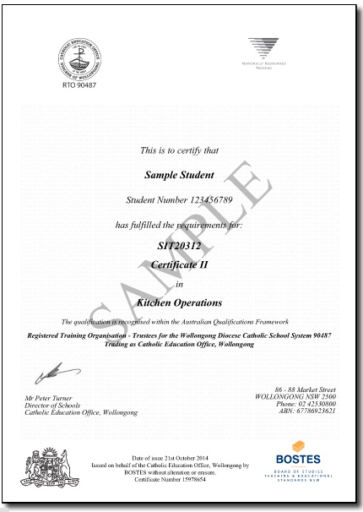
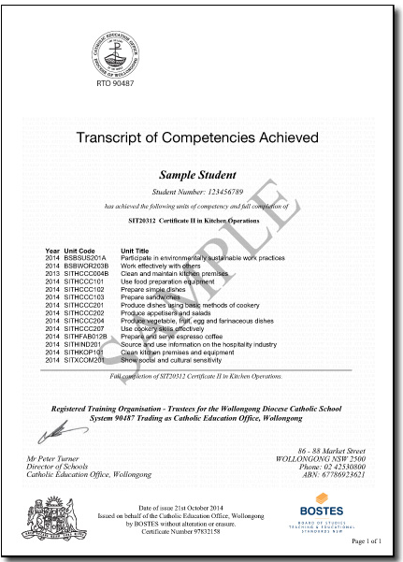
Year 10 Subject Selection for Stage 6
VET Credentials
Notes:
An AQF Certificate is awarded to students in Vocational Education and Training (VET) courses who successfully complete all requirements of an Australian Qualifications Framework (AQF) Certificate.
A Statement of Attainment is issued to students in VET courses who partially complete the requirements of an AQF Certificate.
http://educationstandards.nsw.edu.au/wps/portal/nesa/11-12/hsc/results-certificates/vet-qualifications

Slide 28
Year 10 Subject Selection for Stage 6
School Based Apprenticeships and Traineeships (SBATs)
These can be undertaken in conjunction with a VET course and involve completing a set number of days of paid work placement. (eg Construction 144 days, Automotive 130 days, Hospitality 100 days)
The related VET course can be delivered by the school or by an external provider.
It is the student’s responsibility to find the employer. The school will then pass this information on to the DEC’s SBAT Coordinator who is responsible for establishing the traineeship or apprenticeship.
Notes:
An AQF Certificate is awarded to students in Vocational Education and Training (VET) courses who successfully complete all requirements of an Australian Qualifications Framework (AQF) Certificate.
A Statement of Attainment is issued to students in VET courses who partially complete the requirements of an AQF Certificate.
http://educationstandards.nsw.edu.au/wps/portal/nesa/11-12/hsc/results-certificates/vet-qualifications

Slide 29
HSC Credentials

Slide 30
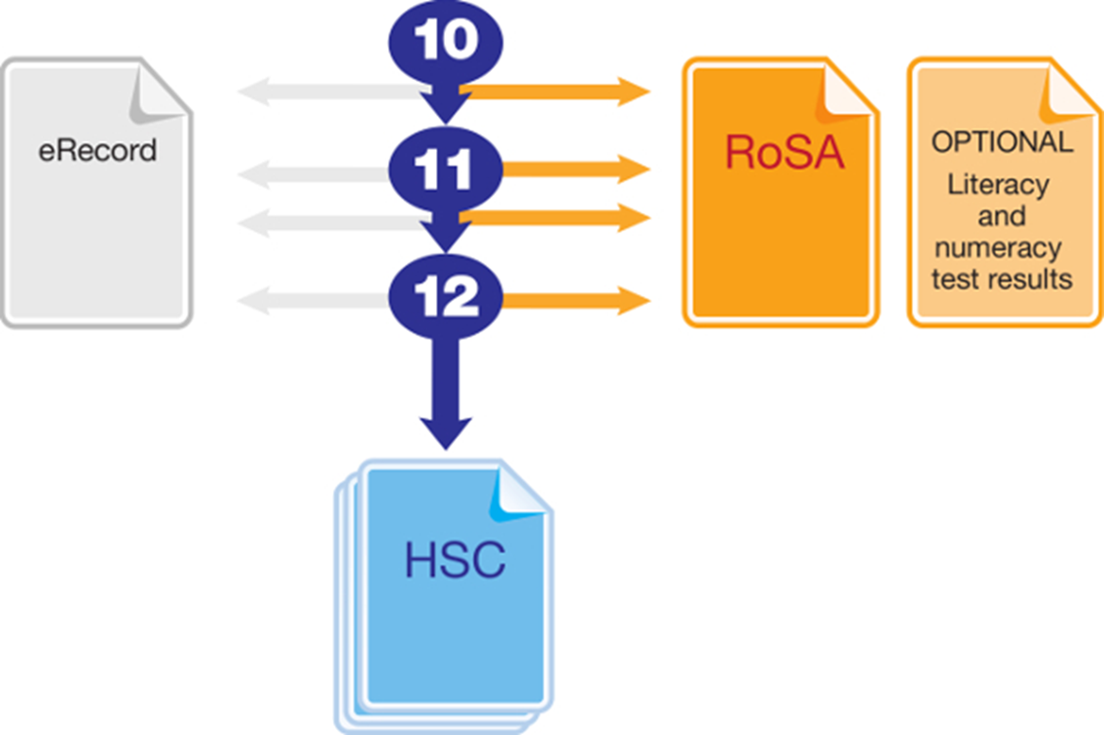
Year 10 Subject Selection for Stage 6
Record of School Achievement
Notes:
Eligible students who leave school before receiving their Higher School Certificate (HSC) will receive the NSW Record of School Achievement (RoSA).
The RoSA is a cumulative credential in that it allows students to accumulate their academic results until they leave school.
The RoSA records completed Stage 5 and Preliminary Stage 6 courses and grades, participation in any uncompleted Preliminary Stage 6 courses and HSC results for students who have not completed their HSC
It is of specific use to students leaving school prior to the HSC.
http://educationstandards.nsw.edu.au/wps/portal/nesa/11-12/leaving-school/record-of-school-achievement
https://studentsonline.bostes.nsw.edu.au/go/seniorstudy/

Slide 31
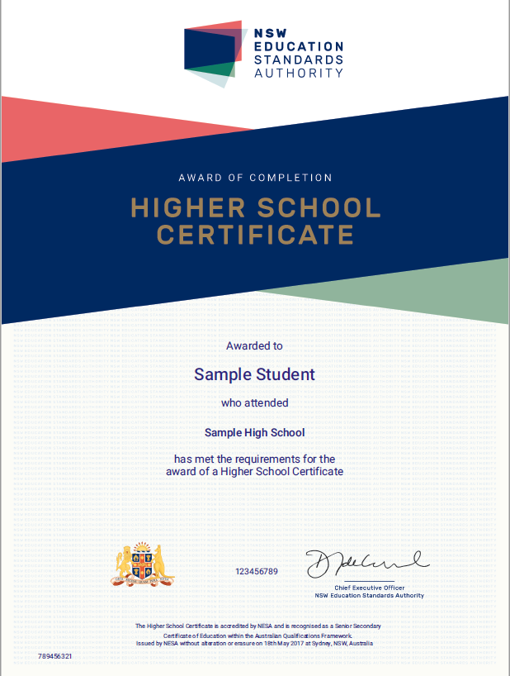
Year 10 Subject Selection for Stage 6
NSW HSC Testamur
Notes:
The HSC testamur is awarded to students who have fulfilled all eligibility requirements for the HSC.
http://educationstandards.nsw.edu.au/wps/portal/nesa/11-12/hsc/results-certificates/results-documentation

Slide 32
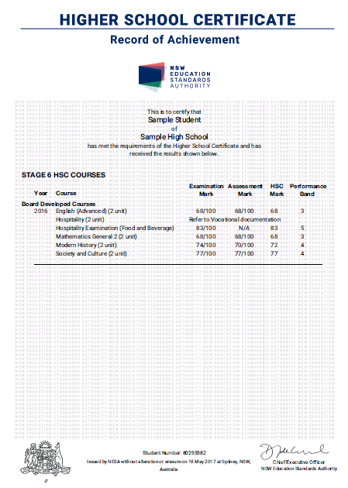
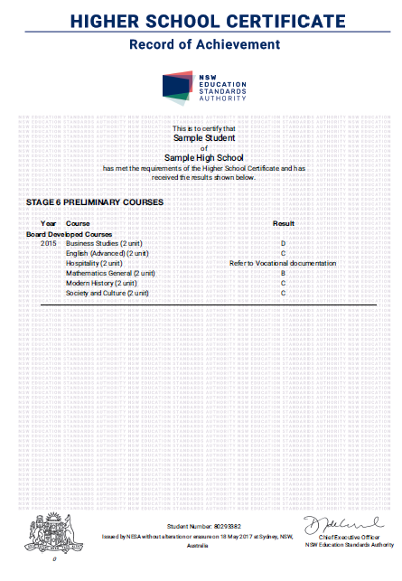
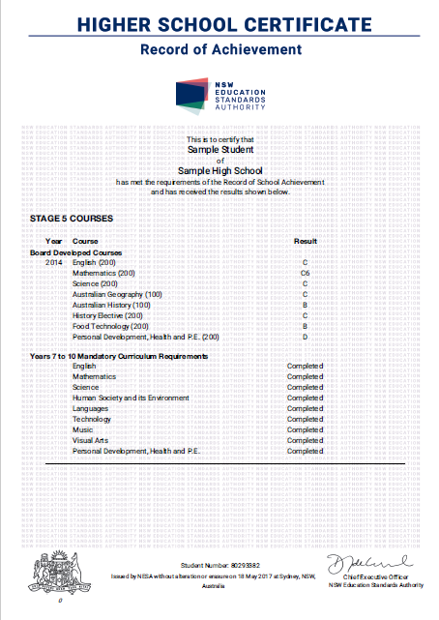
Year 10 Subject Selection for Stage 6
HSC Record of Achievement
Most BDC HSC courses listed with Assessment Mark,
Examination Mark, HSC Mark and Performance Band
All Preliminary and Stage 5 courses will be on separate certificates

Slide 33
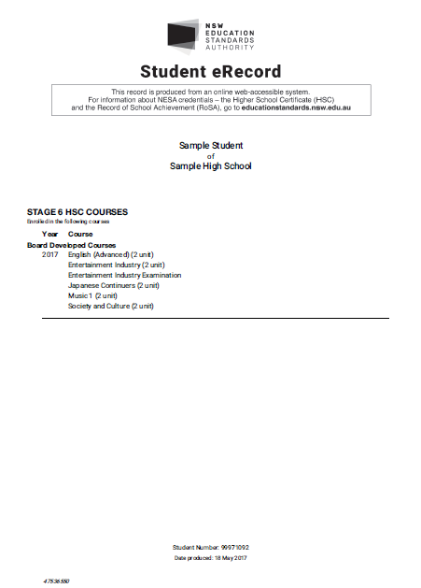
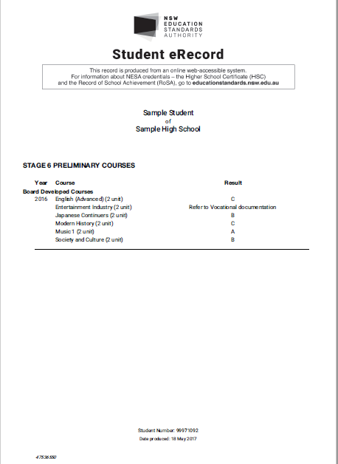
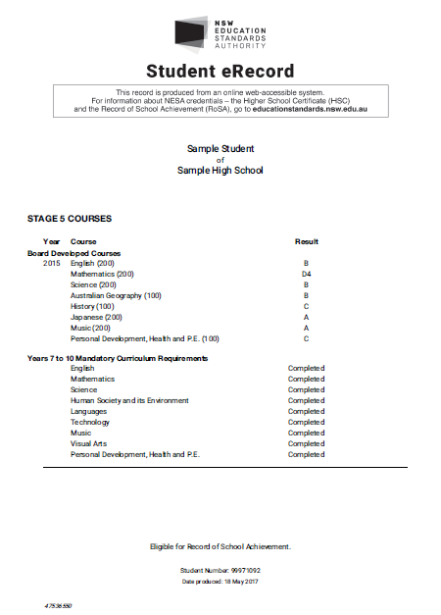
Year 10 Subject Selection for Stage 6

Slide 34
HSC Marks

Slide 35
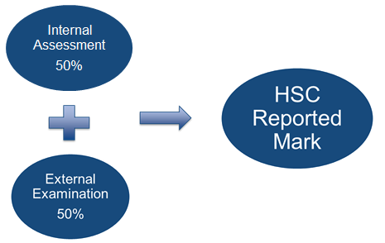
Year 10 Subject Selection for Stage 6
How is the HSC Mark Determined?
Note: The external examination could include a submitted major work
Notes:
Internal Assessment. Why is it important?
Contributes 50% of HSC mark
Is a course completion requirement
May be used to calculate an HSC mark in the case of a successful Illness/Misadventure appeal
School assessment marks in each course are moderated to place them on a state-wide scale.
Examination marks aligned to the standards-based reporting scale contribute 50% of HSC mark.
Some courses have practical examinations and/or submitted works or projects in addition to the written HSC examination.
Written examinations are held in October and November each year.
For each course with a compulsory examination, reported information includes:
Examination mark aligned to the standards-based reporting scale
Moderated assessment mark
HSC mark
Corresponding Performance Band
http://www.boardofstudies.nsw.edu.au/hsc-results/understanding.html

Slide 36
Australian Tertiary Admission Rank

Slide 37
Year 10 Subject Selection for Stage 6
Australian Tertiary Admission Rank
The Australian Tertiary Admission Rank (ATAR):
is for students wishing to gain a place at a university
is a rank NOT a mark
provides information about how a student performs overall in relation to other students
Notes:
UAC will only consider Board Developed Courses in the calculation of the ATAR.
The ATAR provides the discrimination required by universities for the selection process.

Slide 38
Year 10 Subject Selection for Stage 6
ATAR Eligibility Requirements
Satisfactory completion of:
at least 10 units of Board Developed Courses including 2 units of English
at least 4 Board Developed Courses
at least 8 units of Category A courses
No more than 2 units of Category B courses will be used when calculating an ATAR
Notes:
UAC will only consider Board Developed Courses in the calculation of the ATAR.
The ATAR provides the discrimination required by universities for the selection process.

Slide 39
Year 10 Subject Selection for Stage 6
Board Developed Courses and the ATAR
Category A Courses | Category B Courses
May be included in the calculation of a student’s Australian Tertiary Admission Rank (ATAR) | No more than 2 units of Category B courses can be included in the calculation of a student’s ATAR
Compulsory HSC Examination for most courses | Optional HSC examination for some courses
 | Include VET Curriculum Framework courses which have compulsory work placement.
 | Also includes: English Studies Mathematics Standard 1
Notes:
It is the responsibility of the Universities Admission Centre (UAC) to determine if a course can be included in the calculation of the ATAR.
Category A Courses have academic rigour and depth of knowledge to provide background for tertiary studies. Examples include Biology and Geography.
Category B Courses - no more than two units of Category B courses can be included in the ATAR calculation. Examples include Human Services and Hospitality.
Course category listings available at the UAC Website: http://www.uac.edu.au/documents/undergraduate/HSCcourses.pdf

Slide 40
Year 10 Subject Selection for Stage 6
ATAR Calculation
NESA
Examination + Assessment Mark Mark
School
HSC Mark
Universities Admissions Centre
Scaled Marks
The scaled mark for each course is based on the quality of the candidates in that course in that year
www.uac.edu.au
2 units of English + next best 8 units
ATAR
Notes:
UAC will only consider Board Developed Courses in the calculation of the ATAR.
The ATAR provides the discrimination required by universities for the selection process.

Slide 41
Year 10 Subject Selection for Stage 6
Difference Between HSC and ATAR
HSC
is for all students
reports student achievement in terms of a standard achieved in individual courses
presents a profile of student achievement across a broad range of subjects
ATAR
is for students wishing to gain a place at a university
is a rank NOT a mark
provides information about how students perform overall in relation to other students
provides the discrimination required by universities for the selection process
Notes:
UAC will only consider Board Developed Courses in the calculation of the ATAR.
The ATAR provides the discrimination required by universities for the selection process.

Slide 42
Year 10 Subject Selection for Stage 6
Other Considerations
What do I want for my future?
What ‘pathway’ best suits me?
Ask for advice from:
teachers
parents
Year adviser
careers adviser
students in Years 11 and 12
Notes:
http://educationstandards.nsw.edu.au/wps/portal/nesa/11-12/hsc/subject-selection

Slide 43
Year 10 Subject Selection for Stage 6
More Information
www.educationstandards.nsw.edu.au
www.uac.edu.au
Notes:
http://educationstandards.nsw.edu.au/wps/portal/nesa/11-12/hsc/subject-selection

